Slide 1


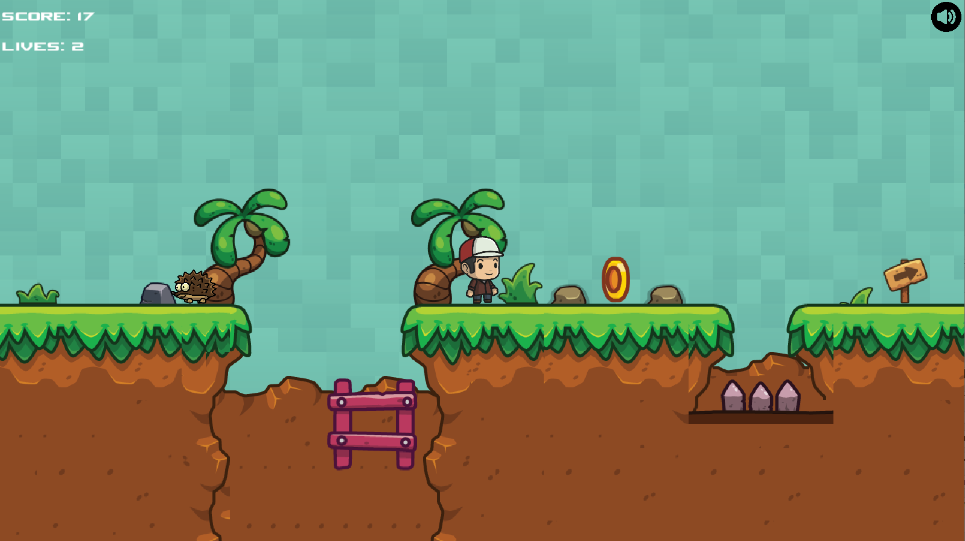
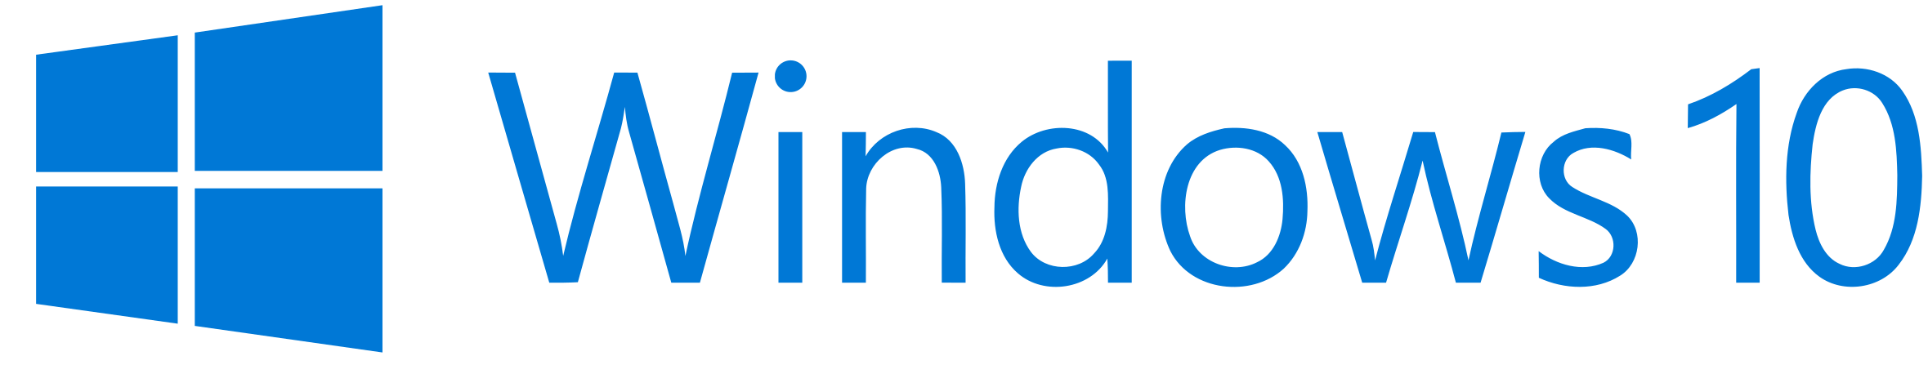

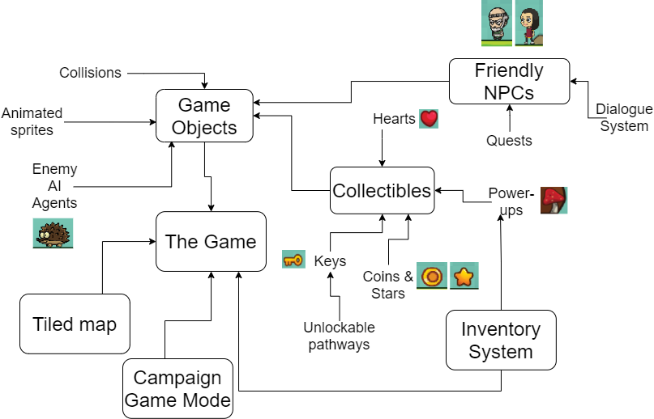
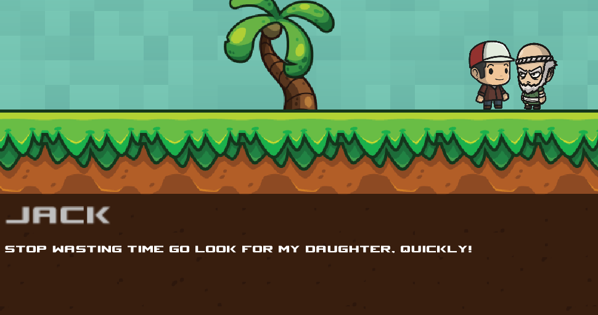
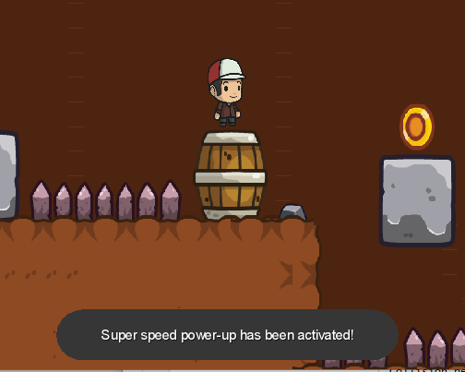




Recreate a classic arcade game
Bartosz Markiewicz Supervisor: Dr Faiyaz Doctor
What?
My project goals have been to create a side-scrolling 2D platformer Mario-inspired game with lite RPG-elements such as friendly NPCs, a text based story narrative and a basic inventory system.
Technical Achievements
All moving objects are animated using my own animation code.
Works on
Wide range of texture assets & sound effects employed.
Why?
When I was younger I enjoyed platformers such as Donkey Kong and Mario. Although my issue with these games was that they were too basic and felt that they were missing something due to having a low amount of interactivity with the game world, eg there were no NPCs to talk to or anything other than avoiding/killing your enemies and reaching the end of the level. . This had influenced me to to recreate the classic side-scrolling Super Mario Bros experience with my own RPG twist on the formula and releasing the game on Android which doesn’t actually have many side-scrolling platformers despite being a perfect fit for the genre.
Feature Diagram
Aims and Objectives
To create a fun and engaging experience.
By finishing ongoing work, having 3 working campaign levels with a coherent storyline and giving the player variety of content by having many different enemy agents, power-ups and dynamic interactive world features.
Release the game on the Android Google app store and itch.io or something similar on Windows.
Ongoing work
Online highscores saving using an SQL database.
More levels.
Endless ‘survival’ game-mode with an infinite procedureally generated map.
More types of and better enemy AI agents.
More power-ups.
How?
Built on
Using

